Slide 1
Digital Logic Design Lab Project
CSE 4206
TEAM MEMBER:
1.Saqif Kaisar (200041121)
2.Fahim Abrar Fuad (200041109)
Submitted To:
Md. Farhan Shadiq

Slide 2
Project Name:
Unbiased Digital Dice with LEDs.
Description:
1. Digital Dice where the dots are defined by 6 LEDs.
2. It is unbiased and nobody can guess its value earlier.
3. Each time switch is on, it will show random number of
LEDs turned on from 1 to 6.

Slide 3
Required Equipments :
1. 6 RED LEDs.
2. A 4017 counter.
3. DCLOCK Generator.
4. A 7408 IC.
5. A 7432 IC.
6. A Button.

Slide 4
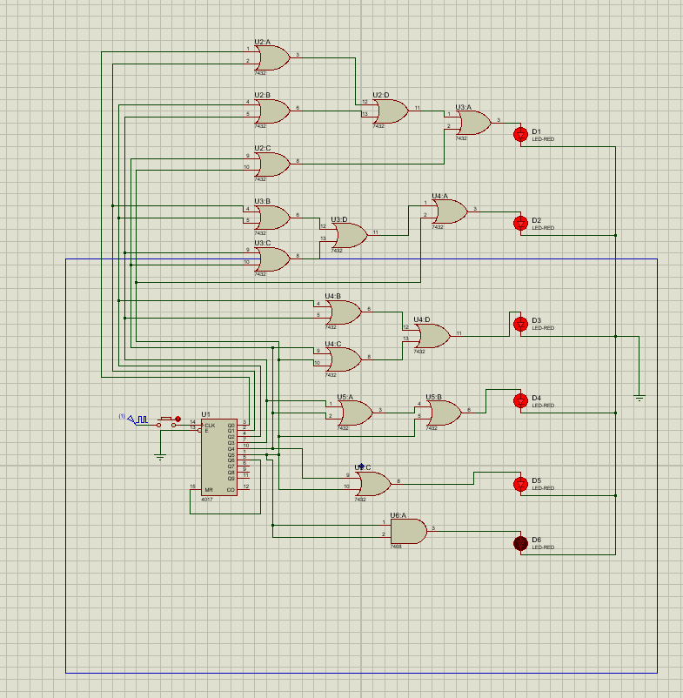
The following project was done using proteus.
Figure: Screenshot of the project on proteus.

Slide 5
Things We have learnt from the project:
1. How to use proteus.
2. How to randomize output.
3. How logic circuit works in practical life.

